Slide 1


School of Computing Science and Engineering
Forecasting of infant mortality rate using machine learning techniques.
Presented by : Vaibhav Singh – 22SCSE1010550
Under the guidance of
Ms. Shailja Thakur
Program Name :
B.Tech CSE

Slide 2

School of Computing Science and Engineering
Introduction:
The project aims to develop a robust predictive model for forecasting infant mortality rates based on comprehensive analysis of previous data sets. It leverages machine learning algorithms and statistical techniques to extract meaningful patterns, identify key indicators, and establish predictive relationships.
Program Name :
B.Tech CSE

Slide 3
School of Computing Science and Engineering
Proposed System:
The proposed system aims to build a predictive model for forecasting infant mortality rates based on a comprehensive analysis of previous data sets. To improve the efficiency of the algorithm, the data will undergo preprocessing, including the removal of outliers and performing necessary data conversions. The collected dataset will be divided into a training set and a test set for prediction.
Project Overview
This project aims to predict the Infant Mortality Rate (IMR) using the Decision Tree Regressor algorithm. IMR is an important indicator of the overall health and well-being of a population, and accurate predictions can help identify areas that require targeted interventions and resources.
Goal
The goal of this project is to develop a predictive model that can accurately estimate the IMR based on various socio-economic, demographic, and healthcare factors. By understanding the key determinants of IMR, policymakers and healthcare professionals can implement effective strategies to reduce infant mortality rates and improve overall public health.
Program Name :
B.Tech CSE

Slide 4
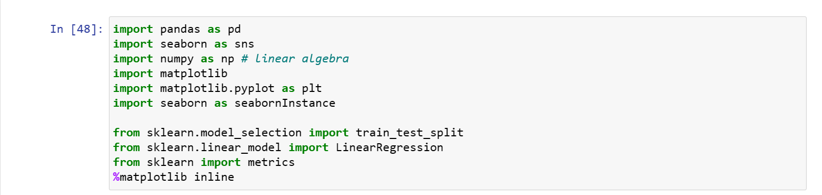
School of Computing Science and Engineering
Technical Implementation:
Program Name :
B.Tech CSE

Slide 5
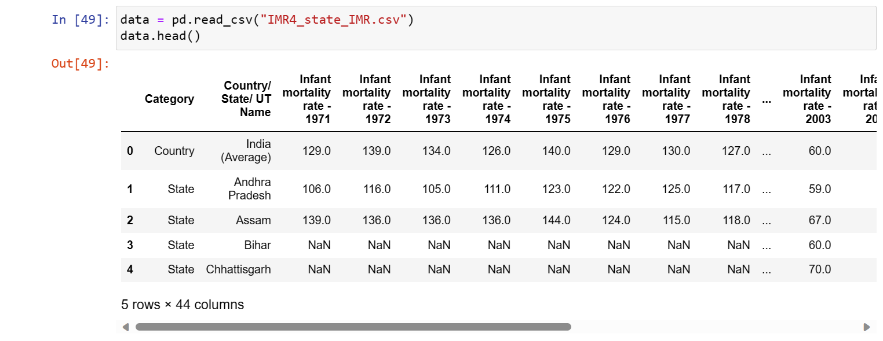
School of Computing Science and Engineering
Data Collection
Program Name :
B.Tech CSE

Slide 6
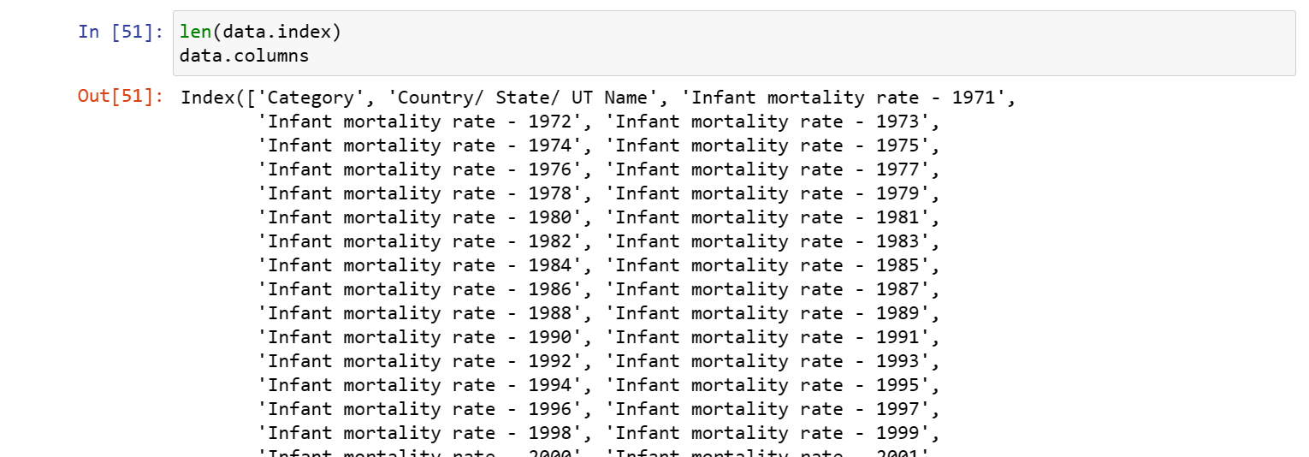
School of Computing Science and Engineering
Data Preprocessing:
Program Name :
B.Tech CSE

Slide 7
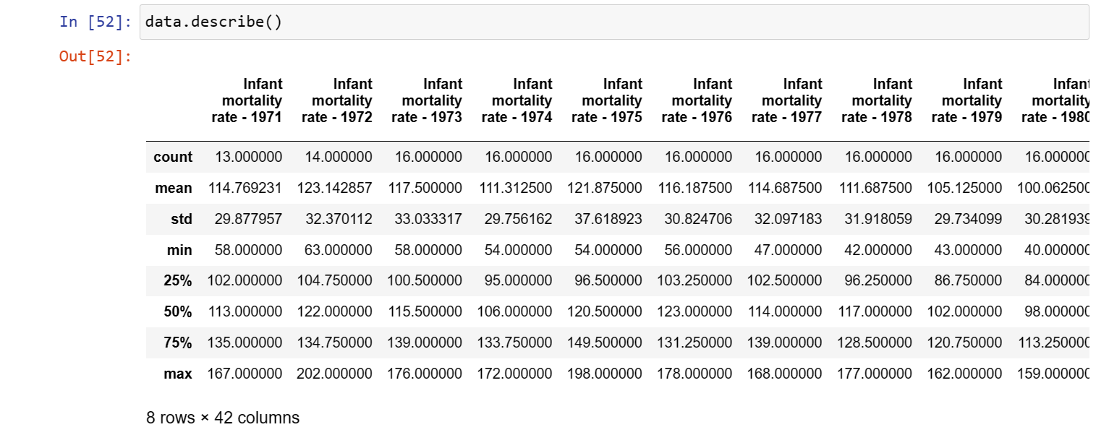
School of Computing Science and Engineering
Feature Selection:
Program Name :
B.Tech CSE

Slide 8
School of Computing Science and Engineering
Model Training:
Decision Tree Regressor Algorithm
The Decision Tree Regressor algorithm is a supervised learning algorithm that is commonly used for regression tasks. It is a non-parametric algorithm that creates a model by recursively partitioning the training data into subsets based on the values of the input features. Each partition is represented by a node in the decision tree, and the output value is determined by the average value of the target variable in that partition.
Program Name :
B.Tech CSE

Slide 9
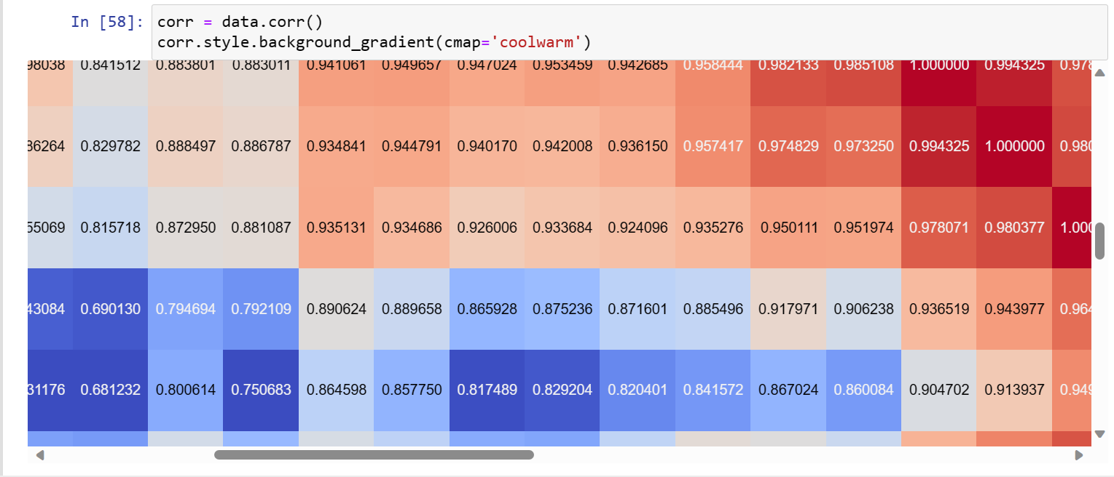
School of Computing Science and Engineering
Model Evaluation
Program Name :
B.Tech CSE

Slide 10
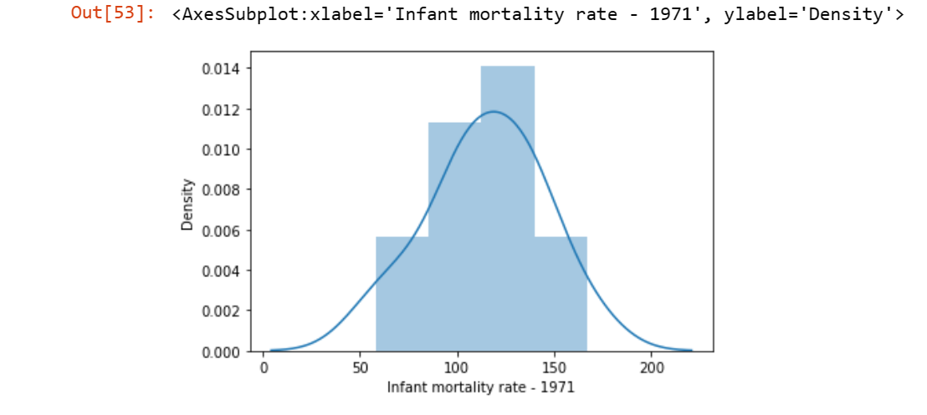
School of Computing Science and Engineering
Model Evaluation
Program Name :
B.Tech CSE

Slide 11
School of Computing Science and Engineering
Conclusion
In conclusion, the IMR prediction project has successfully utilized the Decision Tree Regressor algorithm to predict the Infant Mortality Rate (IMR) based on various factors.
The Decision Tree Regressor algorithm has proven to be effective in capturing the complex relationships between the predictor variables and the target variable, allowing for accurate predictions of IMR.
By analyzing the importance of different features in the decision tree, we have gained valuable insights into the factors that contribute to IMR, such as maternal education, healthcare access, and economic conditions.
The Decision Tree Regressor algorithm has demonstrated its ability to handle both categorical and numerical features, making it a versatile tool for IMR prediction.
Overall, the project has shown that the Decision Tree Regressor algorithm is a valuable tool for predicting IMR and gaining insights into the factors affecting infant mortality. Further improvements can be made by incorporating additional data and exploring other regression algorithms.
Program Name :
B.Tech CSE

Slide 12
School of Computing Science and Engineering
THANK YOU
Program Name :
B.Tech CSE

